Slide 1
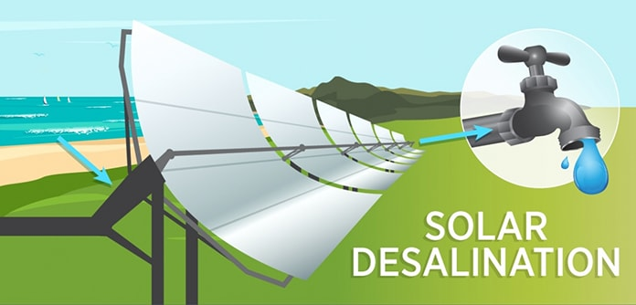
Solar - Powered Water Desalination

Slide 2
index
Why Solar Desalination?
How Solar Desalination Works?
Equipments and Technology used .
Rise of Solar Desalination in India and the World.
Advantages / Disadvantages
Summary

Slide 3


Need for water desalination
Already 4 billion people in face water scarcity. Islands and coastal areas are vulnerable to droughts. The key to unlock extra fresh water lies in the sea. However , desalination is an expensive exercise , as much energy is needed and energy rates are high. So , What if we use Solar Energy for the process?

Slide 4
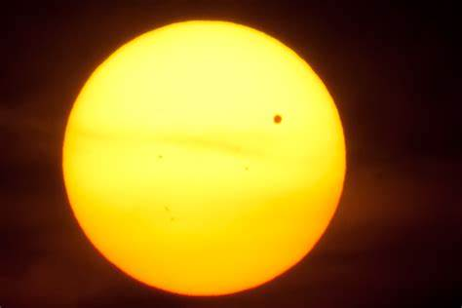
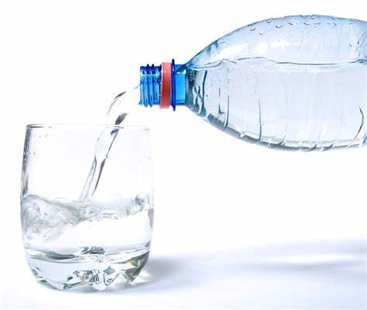
Solar Desalination
Plenty of Sunshine, an abundance of seawater ,
but not a drop to drink ..
Solar Desalination is a technique to desalinate water using solar energy.
A Solar – Powered desalination unit
produces portable water from saline water
through direct or indirect methods of
desalination powered by sunlight.
The key to unlocking more
fresh water lies in the sea.
Solar Desalination provides independence and resilience

Slide 5
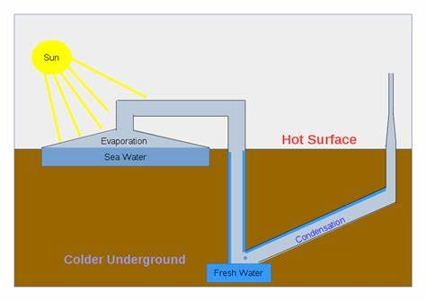
How SOLAR DESALINATION works?
The salt water in the desalination unit is heated by the Sun, converting the liquid to water vapor ( a gas ). As it is heated, the water vapor rises to the top of the unit, collects on the inside lid, and condenses back to liquid as fresh water in a separate collection container.

Slide 6
SOLAR WATER DESALINATION TECHNOLOGIES
Solar powered desalination technologies is categorized into Thermal and Membrane technologies.
Thermal desalination
Examples of thermal desalination
technologies are:
Simple stills
MEH (Multi Effect Humidification)
MED (Multi Effect Distillation)
MES (Multi Effect Solar Desalination)
MSF (Multi Stage Flash)
Membrane desalination
RO (Reverse Osmosis)
EDR (Electrodialysis Reversal)
MD (Membrane Distillation)

Slide 7
CONTI…
The output from a direct solar desalination unit is too low to be employed in a commercial operation. Therefore, indirect solar desalination methods must be utilized to increase freshwater production. Indirect solar desalination combines two different technologies : solar energy collection is coupled with a proven desalination method such as multistage flash(MSF) distillation, multiple effect evaporation (MEE), or reverse organisms(RO).

Slide 8
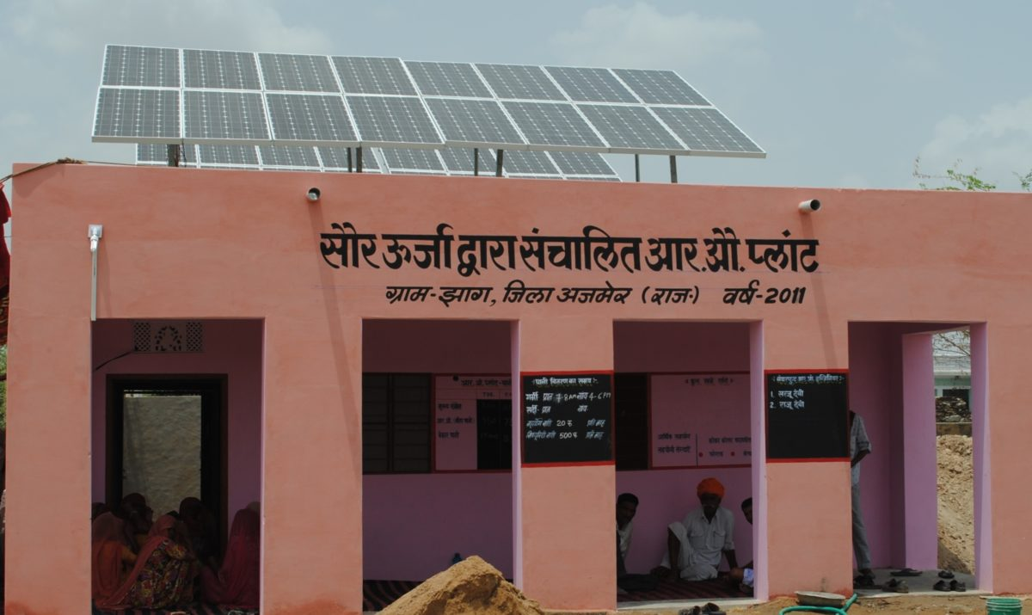
INDIA TAKES TO SOLAR-POWERED DESALINATION
India has joined the nations using PV to produce drinking water after a 10,000-liters-per-day solar-powered desalination plant was set up at the Vivekananda Memorial in Kanyakumari, Tamil Nadu.
The plant was developed by a team from the Indian Institute of Technology – Madras and the Ministry of Earth Sciences funded the Rs.1.22 Crores experimental project.

Slide 9
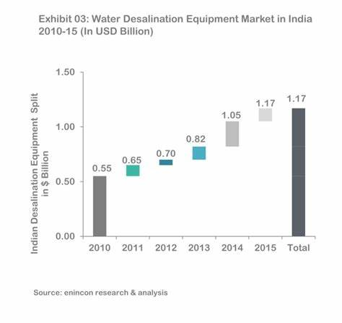
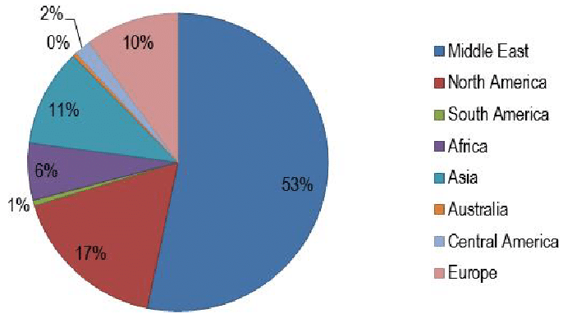
RISE IN INDIA
WORLD SOLAR DESALINATION CHART

Slide 10
Advantages and disadvantages of solar desalination
The advantage of solar desalination is the simplicity of the process which reflects in the limited capital requirements for an installation. For very small-scale fresh water production, solar desalination is competitive compared to the indirect desalination methods.
Disadvantages are the relatively large land area requirements when it’s scaled up and its low efficiency per /m².

Slide 11
summary
Solar Energy coupled to Desalination offers a promising prospect for covering the fundamental needs of power and water in remote regions.
Solar desalination processes direct and indirect collection systems .

Slide 12
Thank You

